Slide 1



Fleet Management Dashboard
View in Power BI
Last data refresh:
27/03/2024 09:20:34 UTC
Downloaded at:
03/04/2024 09:06:20 UTC

Slide 2
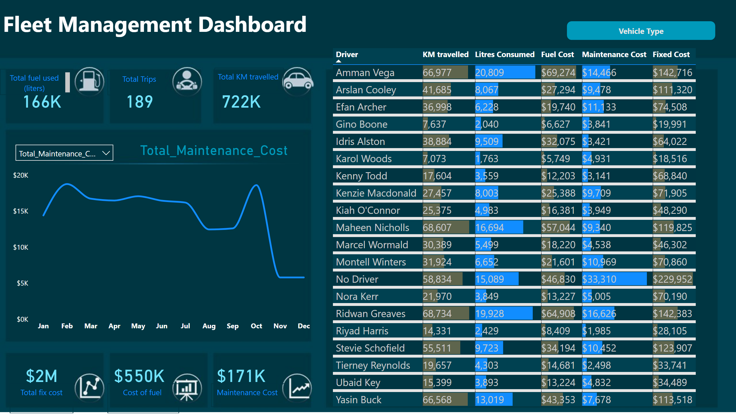
Dashboard
Notes:
tableEx
No alt text provided
lineChart
No alt text provided
slicer
No alt text provided
card
No alt text provided
card
No alt text provided
card
No alt text provided
card
No alt text provided
card
No alt text provided
card
No alt text provided
card
No alt text provided
textbox
No alt text provided
shape
No alt text provided
shape
No alt text provided
slicer
No alt text provided
slicer
No alt text provided
shape
No alt text provided
textbox
No alt text provided
textbox
No alt text provided
textbox
No alt text provided
textbox
No alt text provided
textbox
No alt text provided
textbox
No alt text provided
textbox
No alt text provided

Slide 3
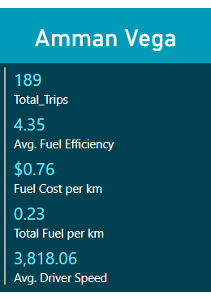
Tooltip
Notes:
multiRowCard
No alt text provided
card
No alt text provided

